Slide 1
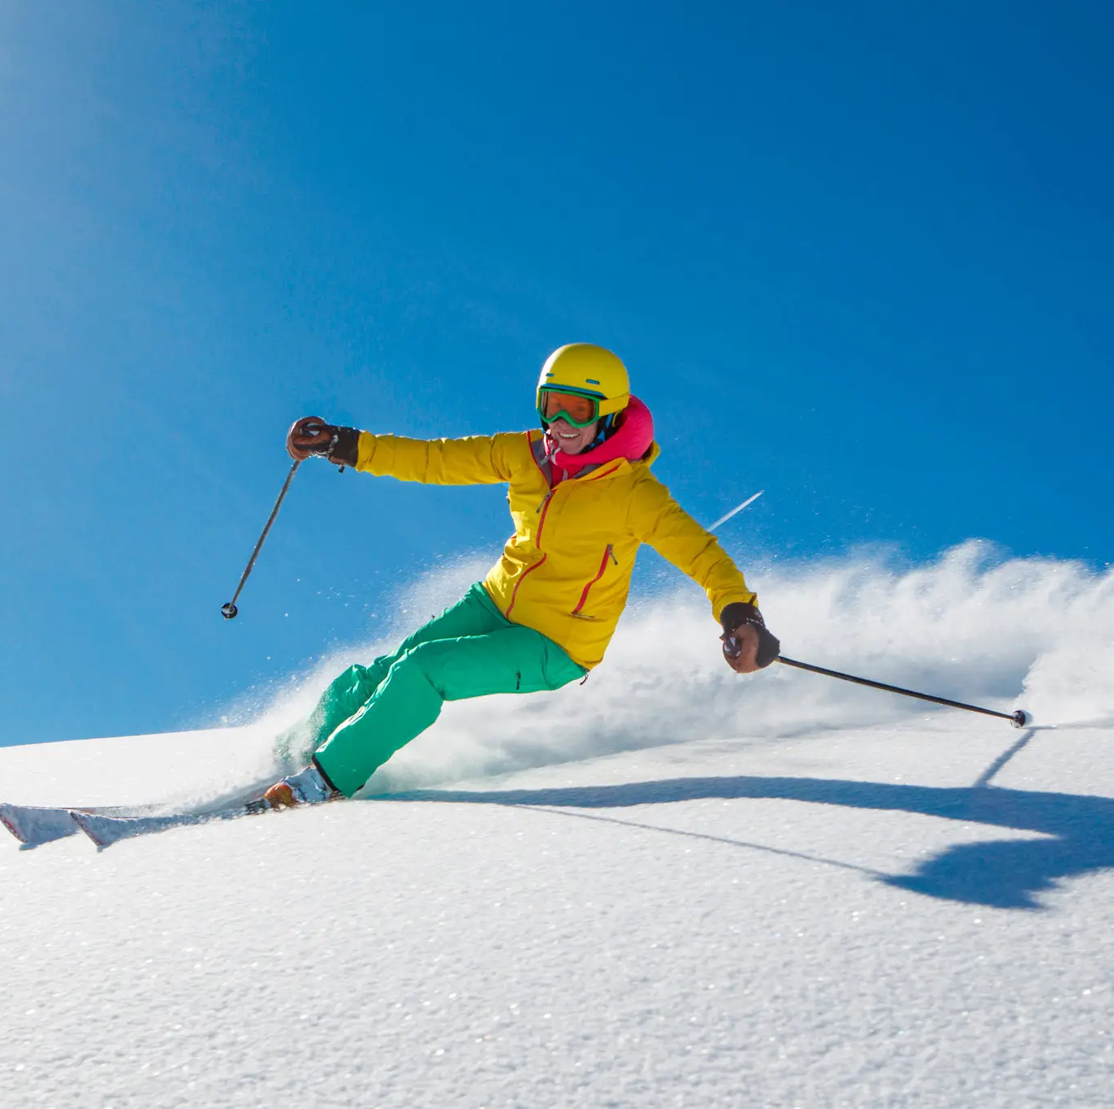
Big Mountain Resort
How can operating costs be cut while selecting a better value for ticket prices to increase revenue for the resort by 20% over one year?

Slide 2
Recommendations
We recommend Big Mountain Resort's ideal ticket price at $95.87, compared to the current price of $81.00.
we recommend implementing Scenario 2: Increasing the Vertical Drop. This could lead to $1.99 further increase in ticket price could lead to an additional $3.47 million in revenue. This scenario offers a balanced approach to enhancing the resort's appeal while generating additional revenue.

Slide 3
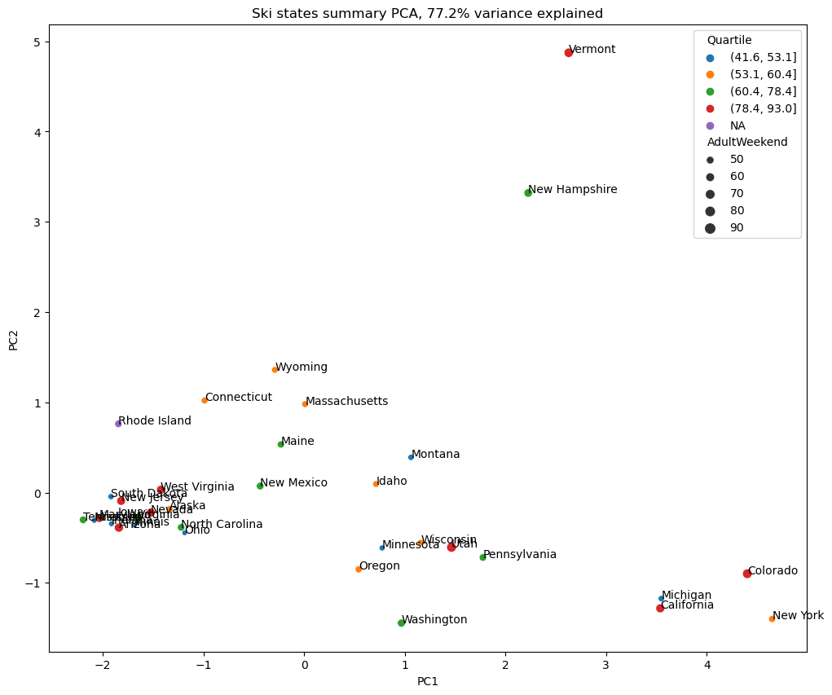
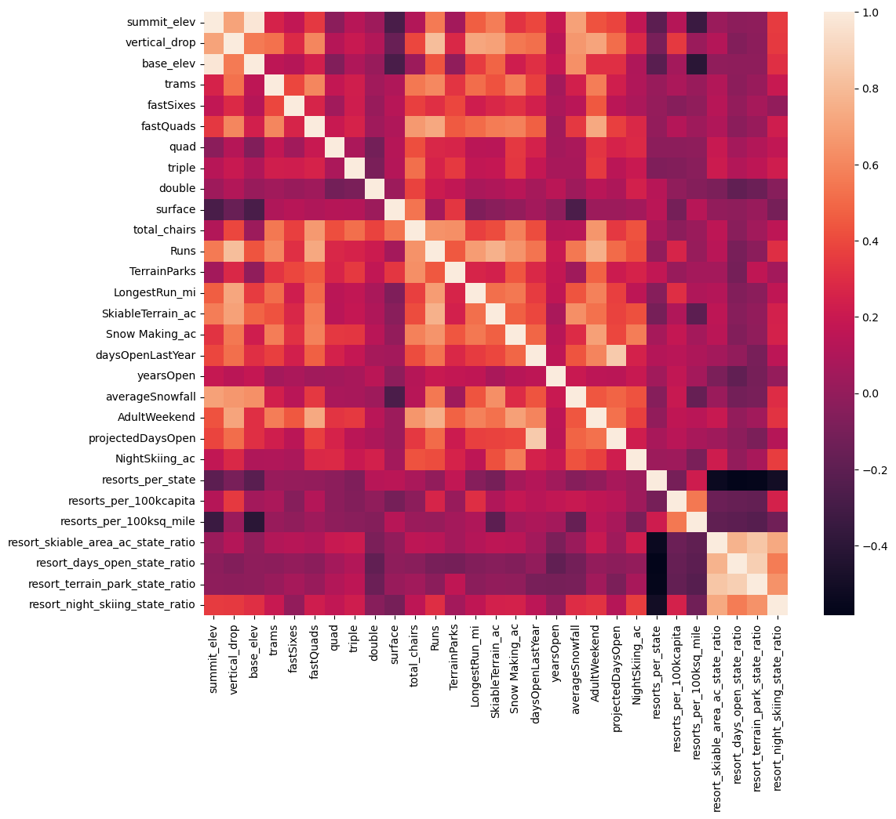
Modeling results and analysis
No obvious pattern with price in PCA plot
Feature correlation heatmap

Slide 4
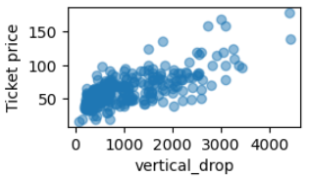
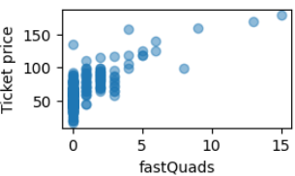
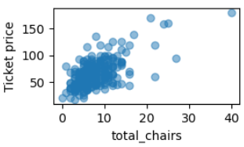
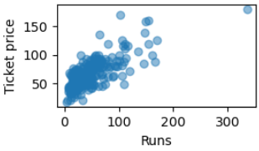
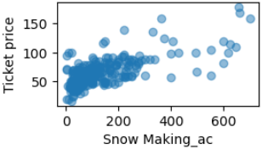
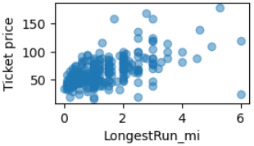
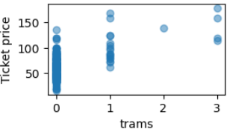
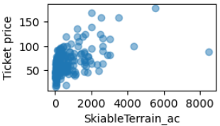
Features that correlated with ticket price

Slide 5
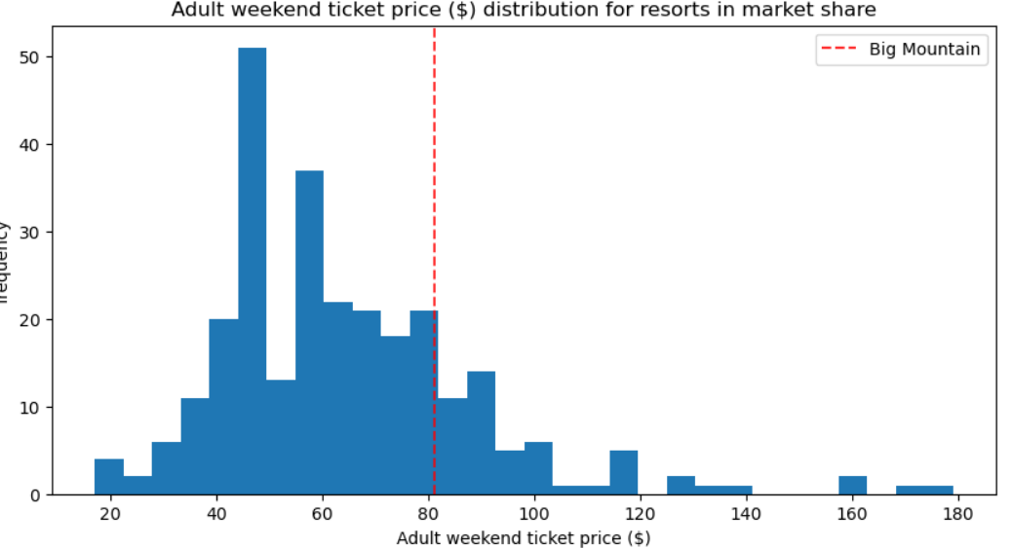
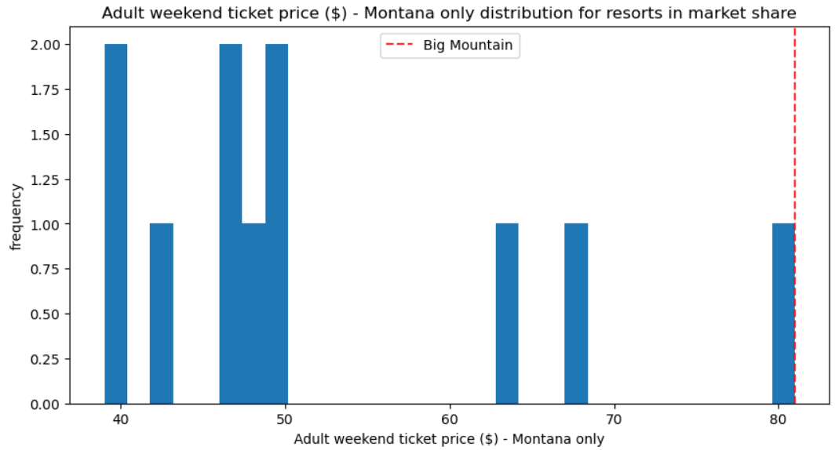
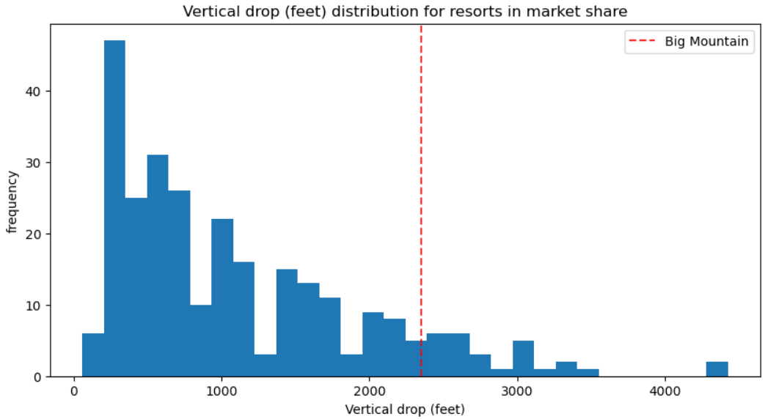
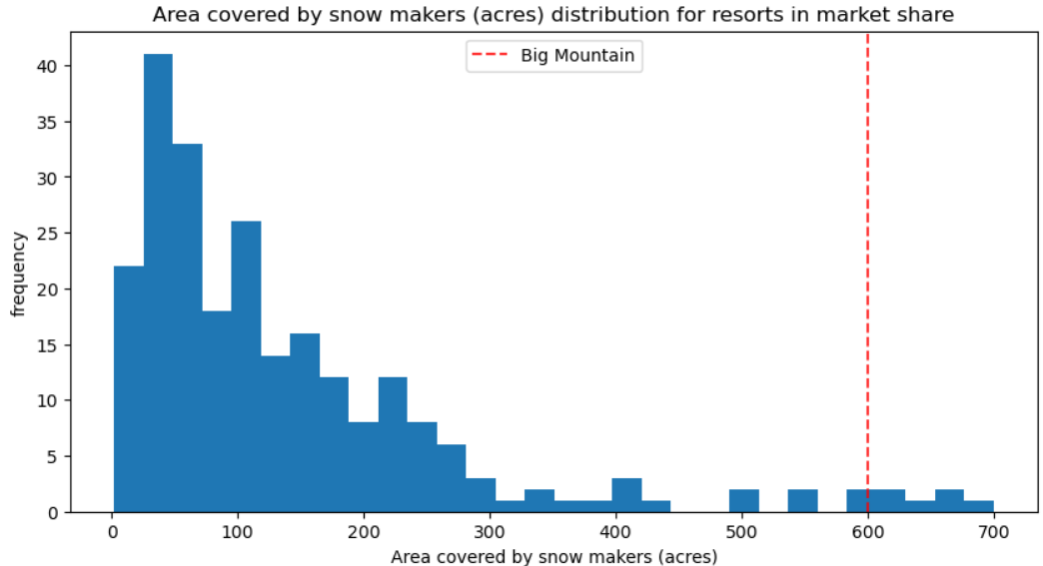
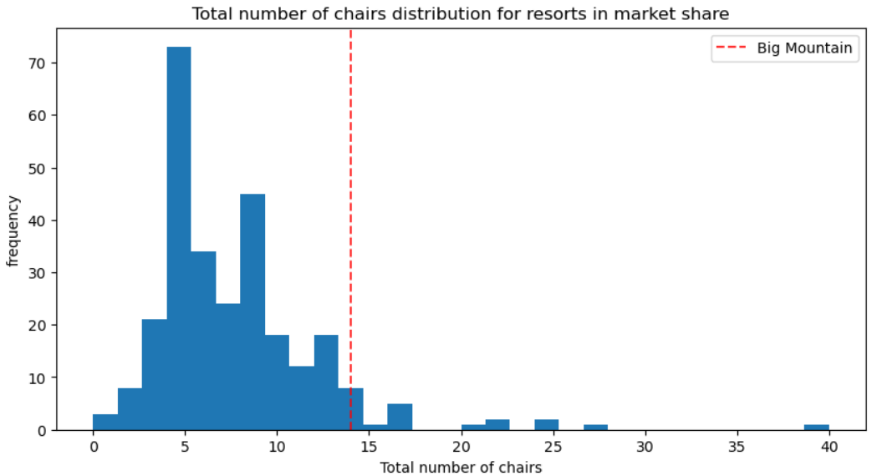
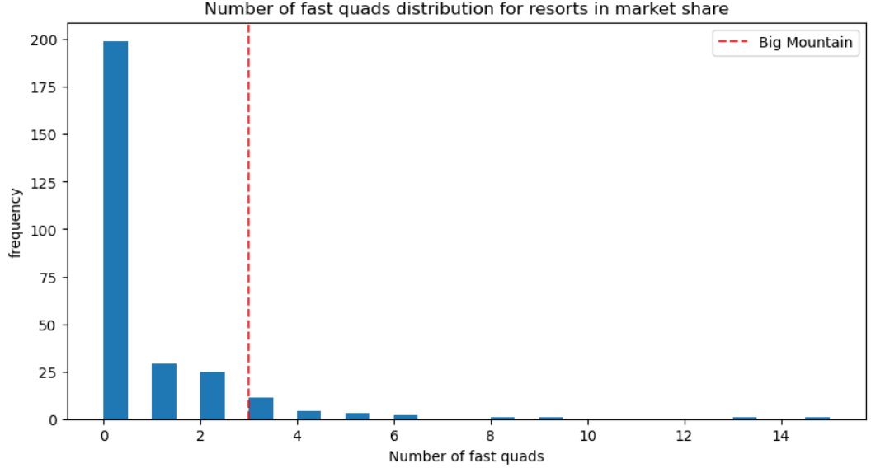
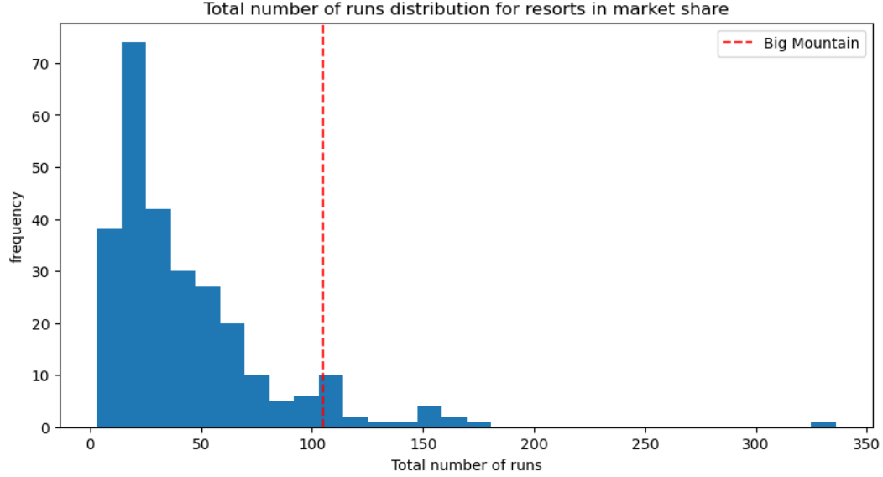
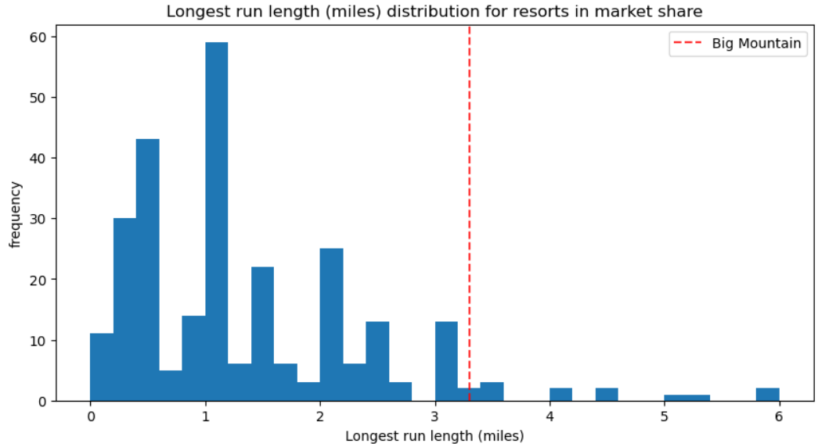
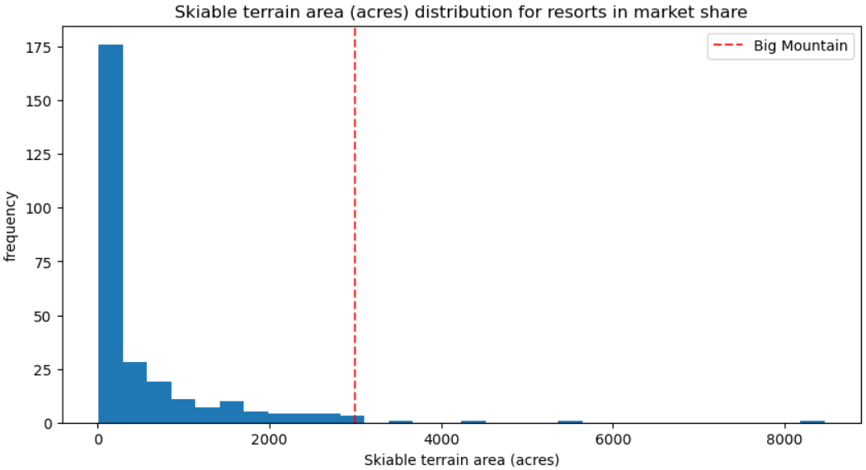
Big Mountain’s relative position in the resort market

Slide 6
Models preprocessing, training and selection
Model 1: Linear regression Model
Model 2: Random forest Model
the dominant top four features are in common: fastQuads, Runs, Snow Making_ac and vertical_drop.
The RandomForestRegressor was chosen for further analysis due to its superior performance.

Slide 7
Summary and conclusion
Increasing the vertical drop and enhancing ticket pricing based on our model's insights offers a promising path for Big Mountain Resort to achieve its revenue goals. Implementing Scenario 2, with an estimated $1.99 increase in ticket price and additional $3.47 million in revenue, is our primary recommendation.

Slide 8
Future Work
To further refine our recommendations and ensure their feasibility, we suggest integrating detailed cost data for operating and maintaining key utilities, including the installation and operating costs for runs, FastQuads, chair lifts, trams, and snow-making per acre. This will enable a comprehensive cost-benefit analysis and help in identifying the most profitable strategies.
Our model provides a robust framework for continuous optimization of pricing strategies in a dynamic market. By making the model user-friendly and accessible to business analysts, Big Mountain Resort can continuously test various scenarios and adapt to changing market conditions.

